Slide 1
Politics and Society in The Civil War
The American Pageant,
Chapters 21-22

Slide 2
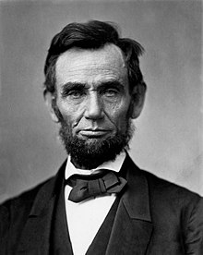
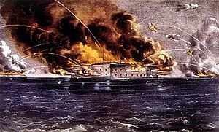
First Shots Fired—1861
Series of events lead to sectionalism
Laws, literature, economics, manifest destiny, Bleeding Kansas, etc.
Secession of states after Lincoln’s election
Lincoln pledges not to interfere with slavery where it already exists
Does not believe secession is legal or right
Actual fighting doesn’t start until 1861
Fort Sumter—South Carolina
Federal arsenal; needs provisions
Lincolns sends necessary supplies, not troops
South fires on Ft. Sumter

Slide 3
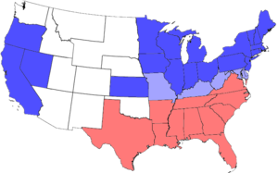
Impact of Ft. Sumter
North unifies behind idea of preserving Union
Lincoln calls on—and gets—volunteers to fight
South unites around the Confederacy
Four more states join (Arkansas, Tennessee, North Carolina, Virginia)
Issue of the Border States
Lincoln wants to keep them in the Union

Slide 4
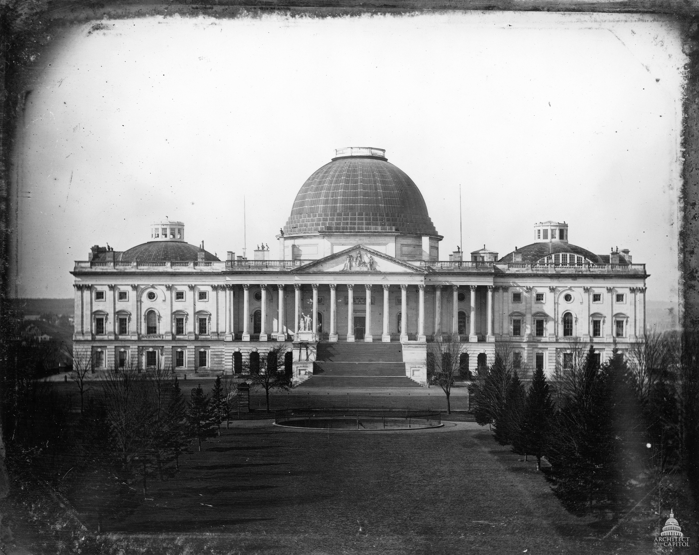
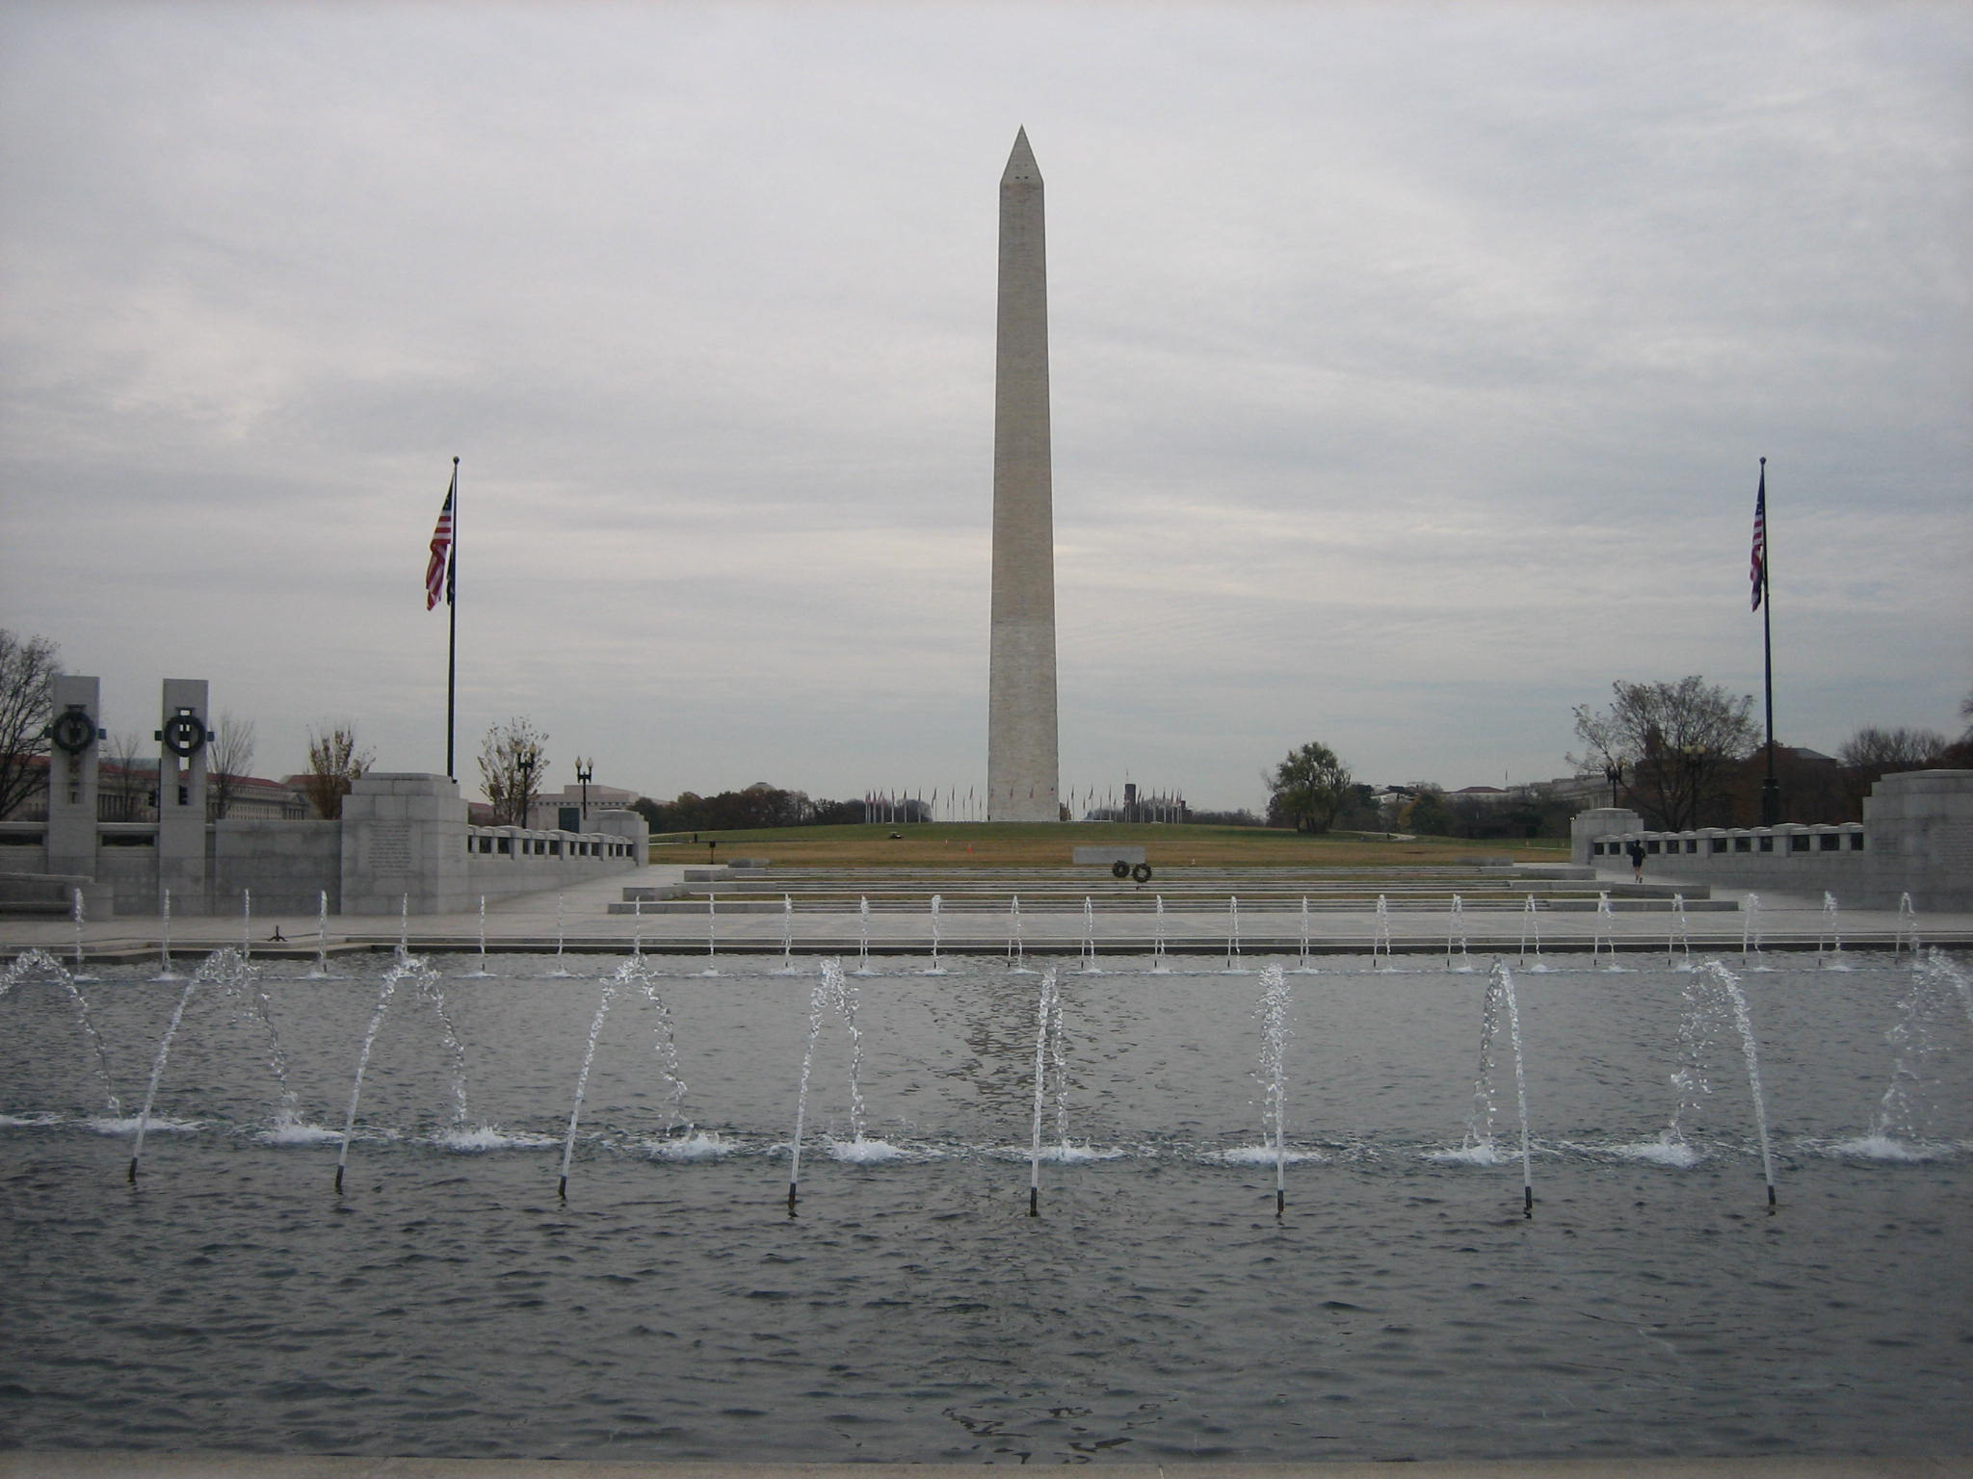
Border States
Important to the war and Lincoln
Missouri, Kentucky, Delaware, Maryland
Slave states till in the Union
Their allegiance provides more soldiers to fight
Would double the manufacturing capacity of South
Geography—Distance matters!
Surround the capital
Lincoln Accomplishes
Keeping Border States:
Martial law in Maryland
Guerilla Warfare in Missouri
Suspension of Habeas Corpus

Slide 5
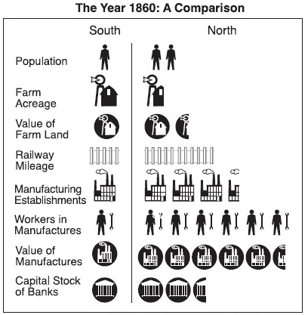
Breaking It Down: The North
Advantages
Disadvantages
Industry
Transportation
Railroad
Navy
Established government
Numbers
22 Million to 9 Million
Emancipation
Lack of leadership
Military leaders defect to South
Lack of purpose
Why fight to keep something that wants nothing to do with us?

Slide 6
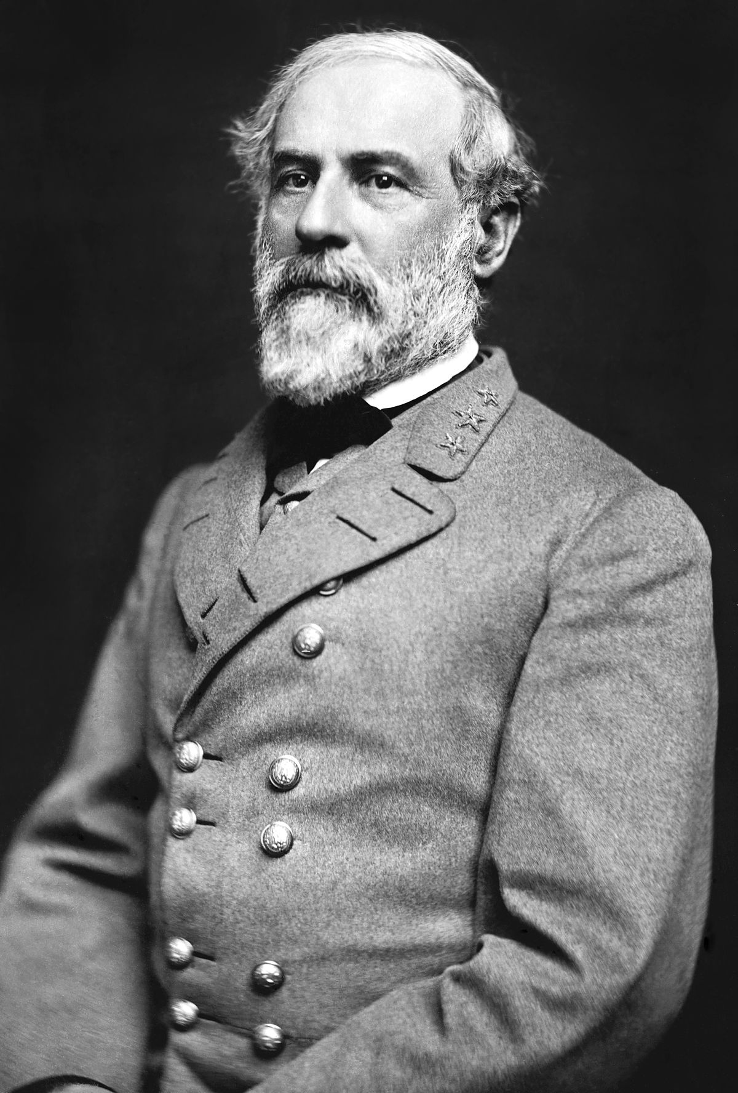
Breaking it Down: The South
Advantages
Disadvantages
Defensive war
Friendly population
Geography
“On their turf”
Sense of purpose
Way of life; Honor
Military leadership
Cotton Diplomacy
Trade with foreign countries
No Navy
No real government structure
Mimics Union
States rights—individualism
Poor society
No transportation
Weak economy
No industry

Slide 7
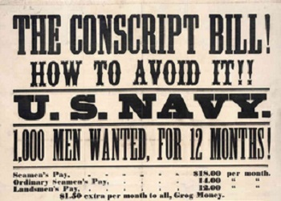
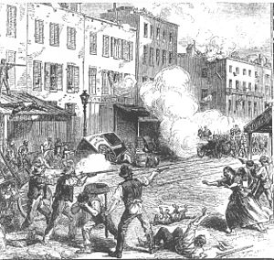
Mobilizing for War: The North
Conscription Act, 1863
First Draft
Applies to men 20-45
Unless you have $300
Riots in NY over the draft
Mobs of Irish Americans attack the wealthy & African Americans

Slide 8
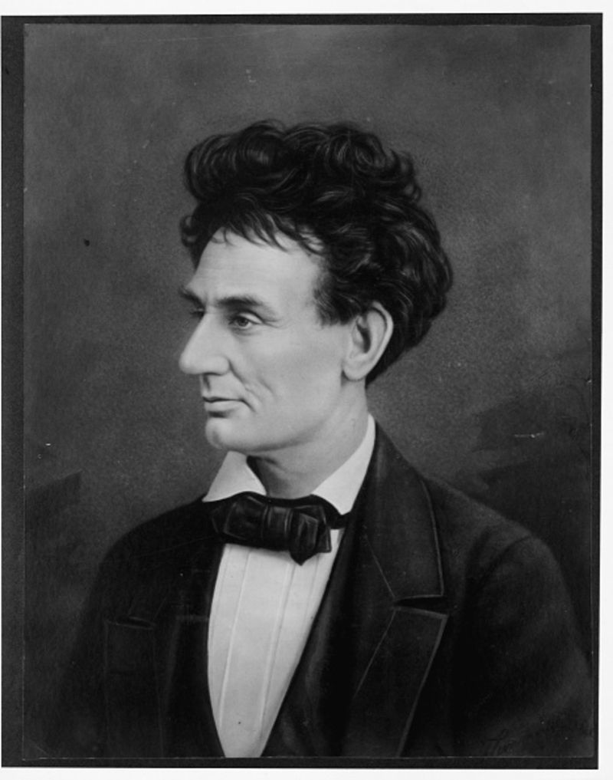
Lincoln’s Purpose for fighting
Preserve the Union; NOT to end slavery
In his mind—
Secession was not legal
Needs support from Border States
Fear from whites—what will emancipation mean for them?
Politically—what would it mean for (R) and (D) in the North?

Slide 9
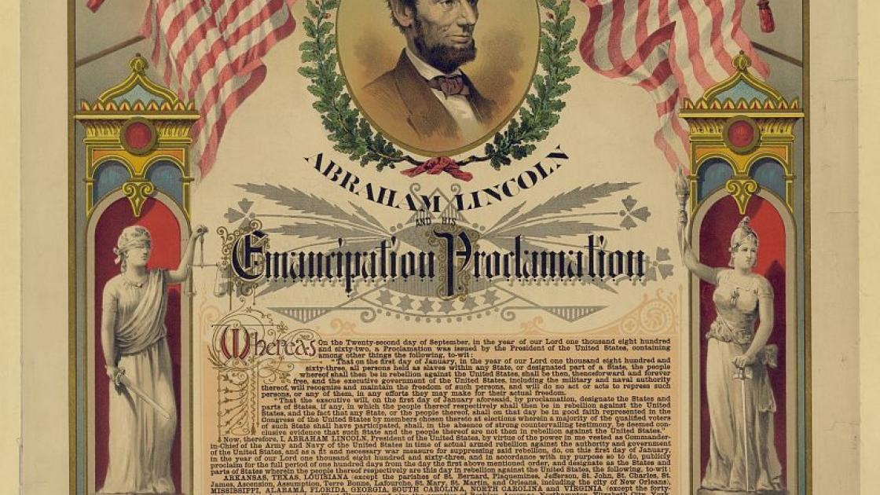
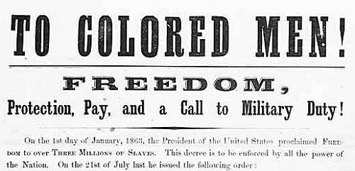
Emancipation
The war eventually becomes about slavery
Emancipation
Why free the slaves?
Militarily: liberating the slaves undermines the South
Ideology: It’s the right thing to do
Radical Republicans
Want the war to be about slavery
Charles Sumner, Thaddeus Stevens, Benjamin Wade
Confiscation Acts (1861, 1862)
Slaves used for “insurrectionary purposes” are free (61)
Slaves of rebels are all freed (62)

Slide 10
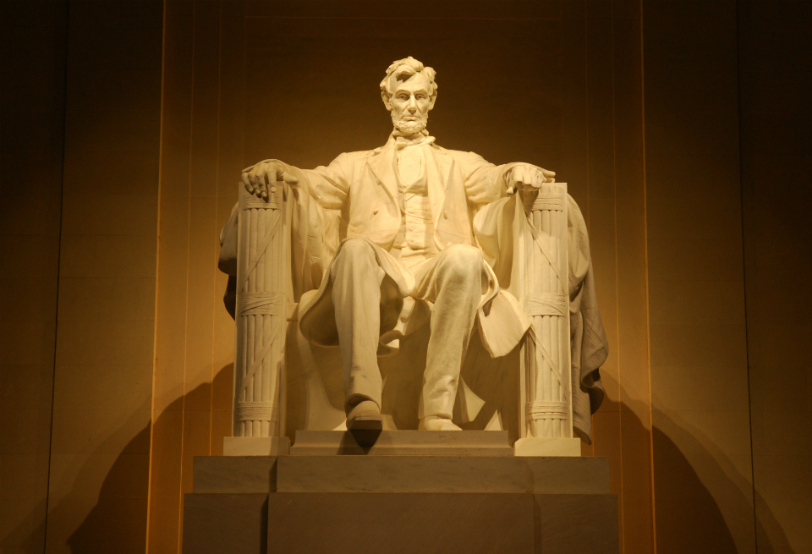
Emancipation Proclamation
1862—Battle of Antietam
Technical draw; but South retreats
Emancipates slaves in rebel territory
Military necessity
Does not free slaves in the Border States
Impact—
Strengthens the North’s cause
Keeps Europeans from supporting the Southern economy
New soldiers sighing up for the North
Two Wrinkles:
1– Does the North have authority over the South?
2—What about the Border States?

Slide 11
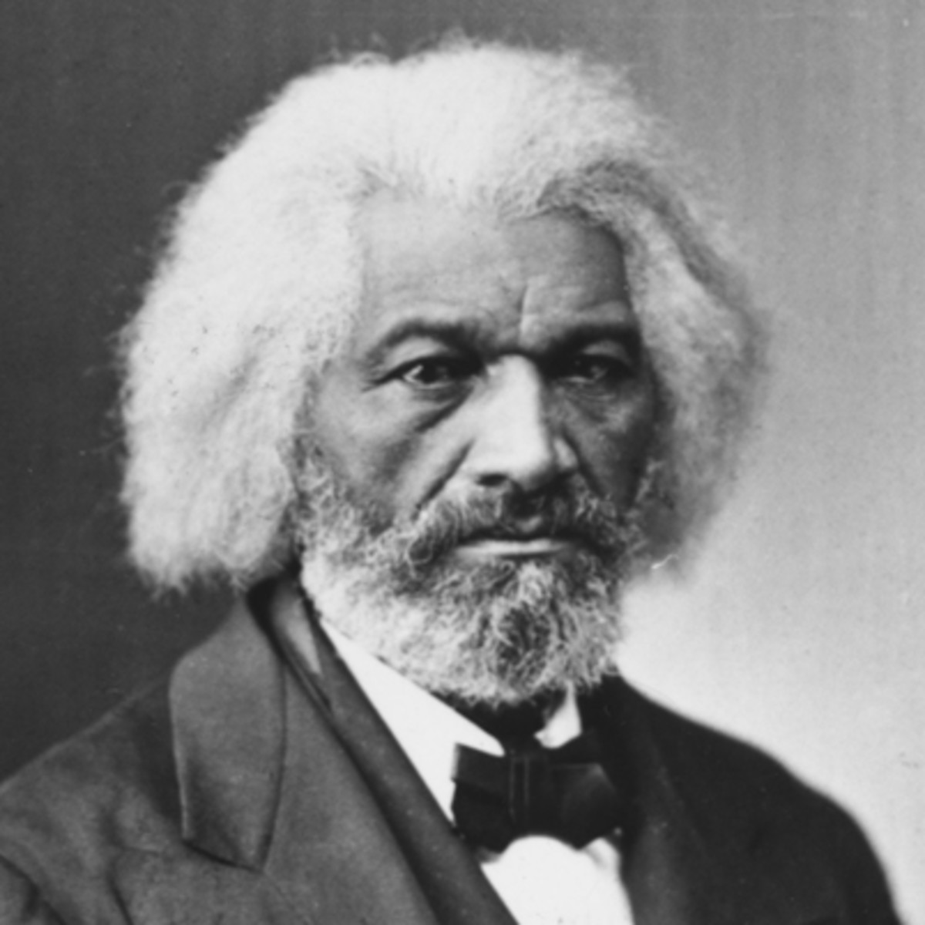
African Americans Fight for Freedom
Frederick Douglas
Enlistment is an opportunity to prove citizenship
Dred Scott
Almost 200,000 serve in the war
Segregation, Discriminatory pay (“Slave Wages”)

Slide 12
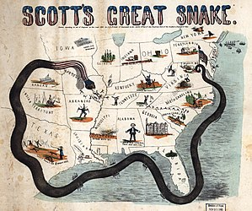
Growth of Executive Authority
During national crises—civil liberties reduced
Similar in kind, different in time
Lincoln…
suspends Writ of Habeas Corpus in Maryland
Arrested without being informed of charges; held without trial
orders a blockade during the war
No approval from congress
Increases size of the army
No approval from Congress
Why?—national security!

Slide 13
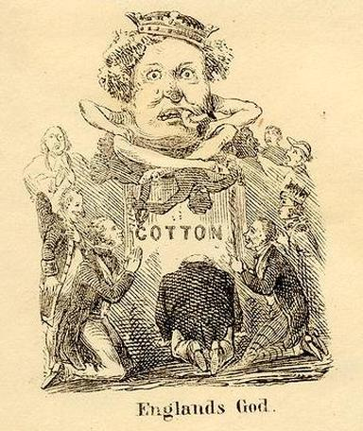
Politics During War
Confederate Challenges
Cotton Diplomacy
Failure!
Europe finds alternate sources of Cotton
Antietam (1862)
Emancipation Proclamation (1863)
States Rights?
Rebellion within the Rebelling Country

Slide 14
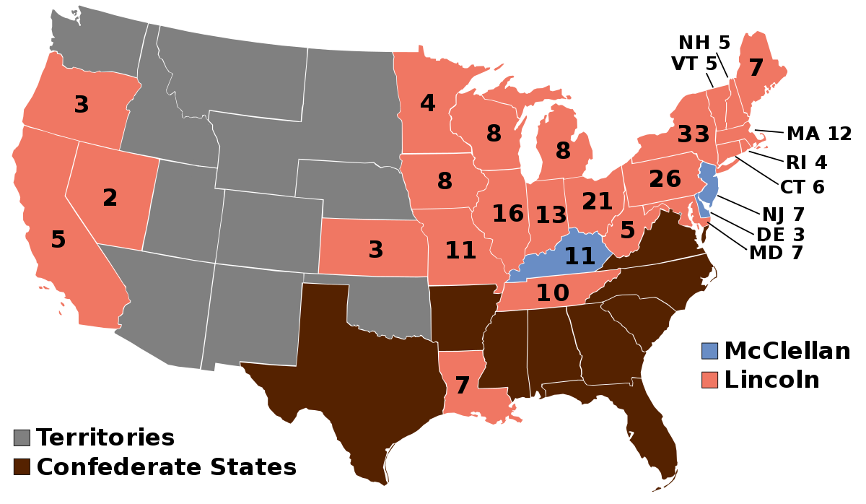
Politics During the War
Union (Lincoln) Challenges
Radical vs. Moderate Republicans
War Democrats—support War, not Lincoln
Peace Democrats (Copperheads)—oppose war; want peace
Election of 1864
Lincoln wins re-election
Cause of Lincoln victory: victory in battle

Slide 15
Republicans in Congress
1861: Morrill Tariff Act—pays for war; industry
1862: Homestead Act—westward expansion; establish homes
1862: Legal Tender Act—Print paper money (greenbacks)
1863: National Bank Act—Unified banking system established
1863: Pacific Railway Act—Northern route for Transcontinental Railroad

Slide 16
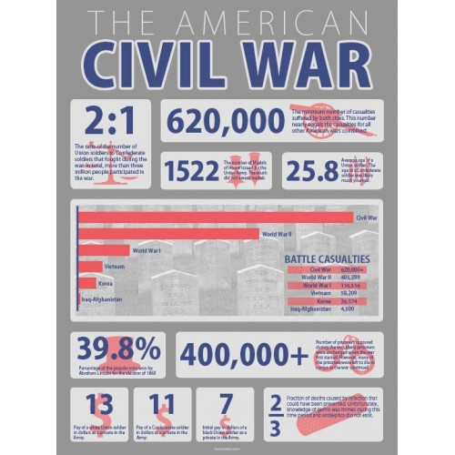
Impact of Civil War
Brother vs. Brother
Deadliest war in US History
3,000,000 soldiers; 600,000 deaths
Southern economy destroyed; Industry of North booms
Growth of Republican Party and Republican Laws
Union saved
Ideas of secession, nullification gone
Ultimate test for American Democracy—it survives
Civil War Amendments: 13, 14, 15
Free. Men. Vote.

Slide 17
A Scene from Lincoln

